Slide 1
Personal Computer Basics
Presentation by group 3

Slide 2
Personal Computer Basics
History
Definition and examples
Parts and Types
Uses

Slide 3
History Of Personal Computer
They were called microcomputers.
It was invented by Edward Robert in 1975
Manufactured by Micro Instrumentation and Telemetry systems(MITS) based on the Intel 8080 CPU.
The MITS Altair 8800 is considered to be the first successful personal computer.

Slide 4
Definition And Examples Of Personal Computer
Personal computer is a small general purpose electronic device created to be utilized by one person at a time.
Some examples are : Apple I & II, Lisa and MacIntosh.

Slide 5
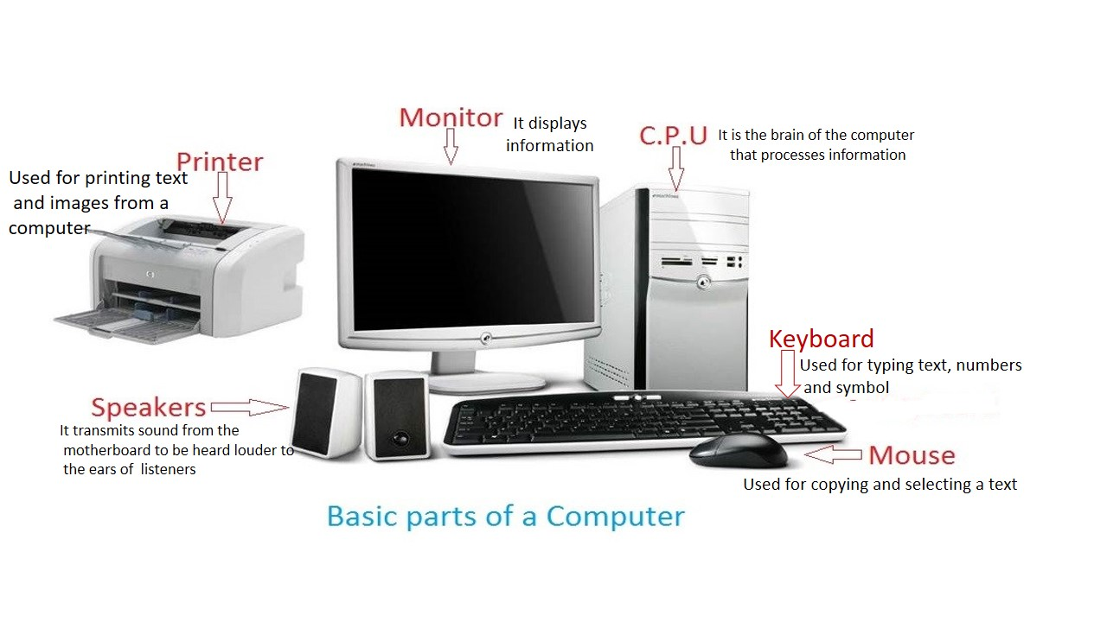
Parts and Types Of Personal Computer
Parts
Types
laptop
Smart phone
Tablet
PDA

Slide 6
Uses Of Personal Computer
For entertainment
For learning and research works
For communication
For business activities for example using spreadsheet to keep records on debtors and creditors

Slide 7
Group Members
EH/ACT/18/0023
EH/ACT/18/0024
EH/ACT/18/0025
EH/ACT/18/0026
EH/ACT/18/0027
EH/ACT/18/0028
EH/ACT/18/0029
EH/ACT/18/0030
EH/ACT/18/0031
EH/ACT/18/0032

